Slide 1
Software Design Basic concepts
Unit -3
Prepared by: Neha Tripathi

Slide 2
Software design and its activities
https://www.youtube.com/watch?v=XDL4dnAMn8s
Software design deals with transforming the customer requirements, as described in the SRS document, into a form (a set of documents) that is suitable for implementation in a programming language.
Following items are designed during the design phase:
• Different modules required to implement the design solution.
• Control relationship among the identified modules. The relationship is also known as the call relationship or invocation relationship among modules.
• Interface among different modules. The interface among different modules identifies the exact data items exchanged among the modules.
• Data structures of the individual modules.
• Algorithms required to implement each individual module.

Slide 3
Design activities
Design activities can be broadly classified into two important parts:
Preliminary (or high-level) design :
High-level design means identification of different modules and the control relationships among them and the definition of the interfaces among these modules. The outcome of high-level design is called the program structure or software architecture, i.e. Structured chart
Detailed design:
During detailed design, the data structure and the algorithms
of the different modules are designed. The outcome of the detailed design stage is usually known as the module-specification document.

Slide 4
Characteristics of a good software design
https://www.youtube.com/watch?v=lzLwVGLNMqQ&list=PLz8TdOA7NTzQJ62qHgIfwZmRWt-EAMn-W&index=60
https://www.geeksforgeeks.org/introduction-of-software-design-process-set-2/
• Correctness: A good design should correctly implement all the functionalities identified in the SRS document.
• Understandability: A good design is easily understandable.
• Efficiency: It should be efficient.
• Maintainability: It should be easily amenable to change.

Slide 5
Continue….
Understandability of a design is a major issue:
-determines goodness of design:
-a design that is easy to understand
-also easy to maintain and change
Unless a design is easy to understand,
-tremendous effort needed to maintain it
- maintenance effort would increase many times.
- We already know that about 60% effort is spent in maintenance.

Slide 6
Continue…..
In order to facilitate understandability, the design should have the following features:
Use consistent and meaningful names
-for various design components,
Design solution should consist of:
-a cleanly decomposed set of modules (modularity),
Different modules should be neatly arranged in a hierarchy:
-in a neat tree-like diagram.

Slide 7
Modularity
Modularity is a fundamental attributes of any good design.
-Decomposition of a problem cleanly into modules:
-Modules are almost independent of each other
-divide and conquer principle.
Module Independence
If modules are independent:
-modules can be understood separately,
-reduces the complexity greatly.
To understand why this is so,
-remember that it is very difficult to break a bunch of sticks but very easy to break the sticks individually.

Slide 8
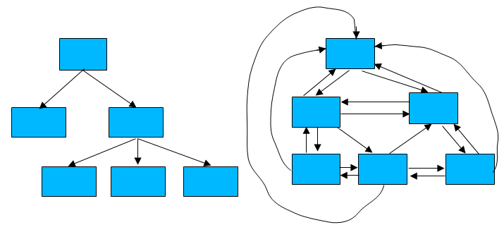
Example of Cleanly and Non-cleanly Decomposed Modules

Slide 9
Neat arrangement of modules
low fan-out
Abstraction
Depth:
-number of levels of control
Width:
- overall span of control.
Fan-out:
-A measure of the number of modules directly controlled by given module.
Fan-in:
-indicates how many modules directly invoke a given module.
-High fan-in represents code reuse and is in general encouraged.

Slide 10
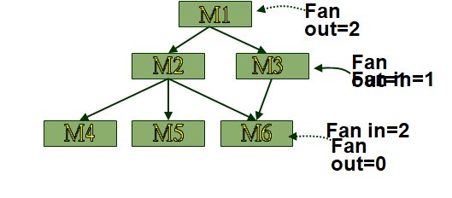
Fan-in/Fan-out

Slide 11
Thank You!

